Slide 1
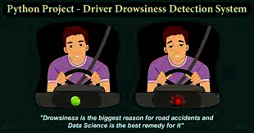
.....
....
Project
Driver Drowsiness Detection system
Gadapwar Saiprasad

Slide 2
Problem Statement
In this Python project, we will be making a drowsiness detection system. A countless number of people drive on the highway day and night. Taxi drivers, bus drivers, truck drivers and people traveling long-distance suffer from lack of sleep. Due to which it becomes very dangerous to drive when feeling sleepy.
The majority of accidents happen due to the drowsiness of the driver. So, to prevent these accidents we will build a system using Python, OpenCV, and Keras which will alert the driver when he feels sleepy.

Slide 3
Project Design
In this Python project, we will be using OpenCV for gathering the images from webcam and feed them into a Deep Learning model which will classify whether the person’s eyes are ‘Open’ or ‘Closed’.
The approach we will be using for this Python project is as follows :
Step 1 – Take image as input from a camera.
Step 2 – Detect the face in the image and create a Region of Interest (ROI).
Step 3 – Detect the eyes from ROI and feed it to the classifier.
Step 4 – Classifier will categorize whether eyes are open or closed.
Step 5 – Calculate score to check whether the person is drowsy.

Slide 4
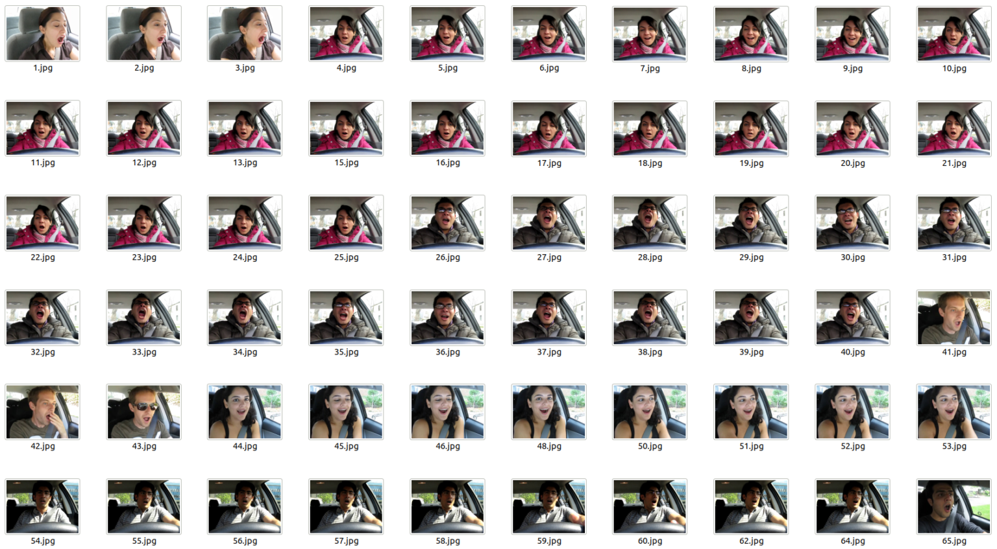
Data Collection and Preprocessing
The dataset used for this model has taken from https://data-flair.training/blogs/download-driver-drowsiness-detection-project-data/
Driver Drowsiness Data
The dataset consists of 2900 images which include both normal and yawning images. Dataset is divided into training and testing, which is used in the project for training and testing respectively.

Slide 5
Machine Learning Models
Convolutional Neural Networks
The model we used is built with Keras using Convolutional Neural Networks (CNN). A convolutional neural network is a special type of deep neural network which performs extremely well for image classification purposes. A CNN basically consists of an input layer, an output layer and a hidden layer which can have multiple layers. A convolution operation is performed on these layers using a filter that performs 2D matrix multiplication on the layer and filter.

Slide 6
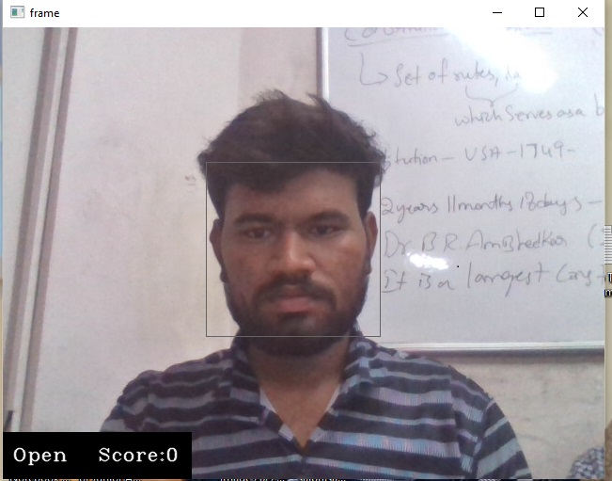
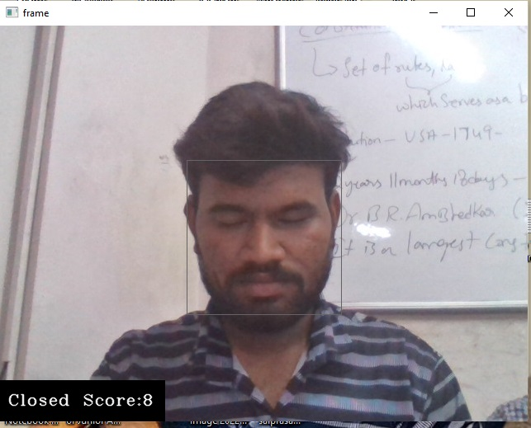
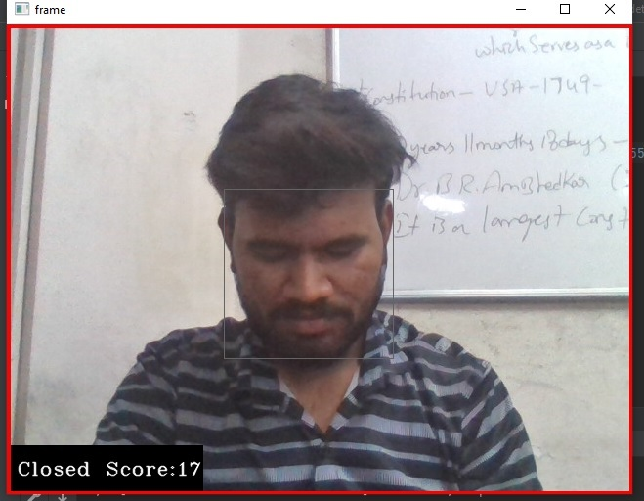
Project Output
identification of drowsiness at various conditions
Case 1:Eyes open
Case 2:Eyes closed
Case 3:Eyes closed at >15 score

Slide 7
Future Scope and Usability
ADVANTAGES:-
The detected abnormal behavior is corrected through alarms in real time.
Life of the driver can be saved by alerting him using the alarm system.
Speed of the vehicle can be controlled.
Traffic management can be maintained by reducing accidents.
APPLICATIONS:-
This system can be used in factories to alert the workers.
If found drowsy, the alarm system gets activated and the driver is alerted.
If there is any obstacles it is alerted to the driver.
This system can also be used for railway drivers

Slide 8
Project Data Links
Project Code / Colab Notebook / Public Github Link
Project Video Link

Slide 9




www.hexart.in
Sponsored by
THANK YOU
CSR Partner
Implementation Partner

